Slide 1
Pool Testing

Slide 2
Pool Testing
Let’s review the infographic “Pool Testing”
Notes:
Note : If you have downloaded the infographic to your computer, you can edit the presentation to generate a hyperlink to the video from this slide.

Slide 3
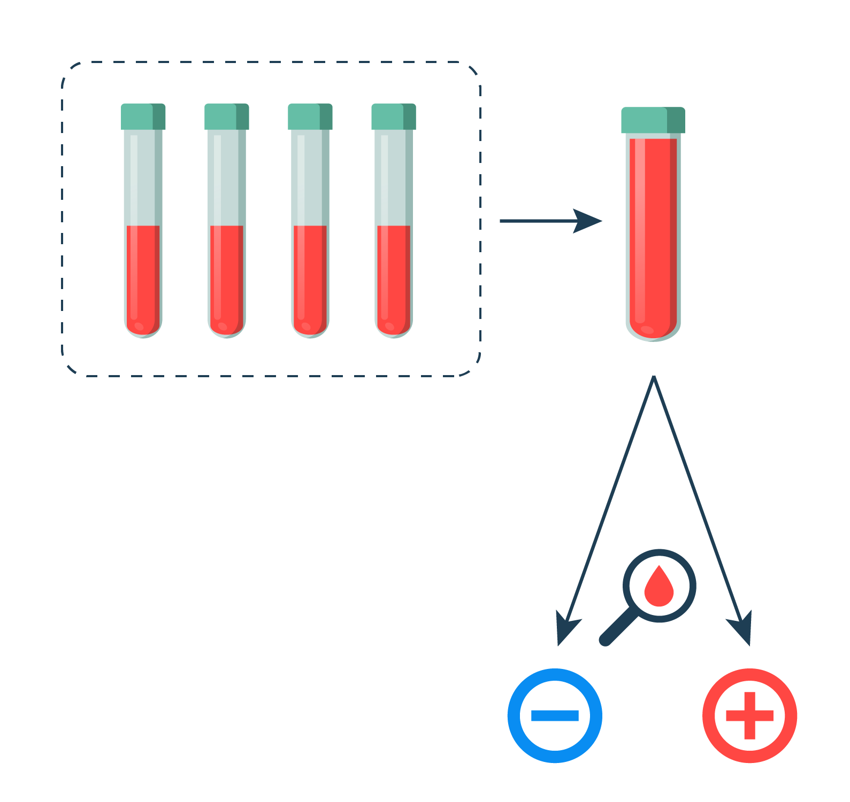
Pool Testing
What is pool testing?
Why is it necessary to divide each individual sample into two?
What advantage does pool testing have over individual sample analysis?

Slide 4
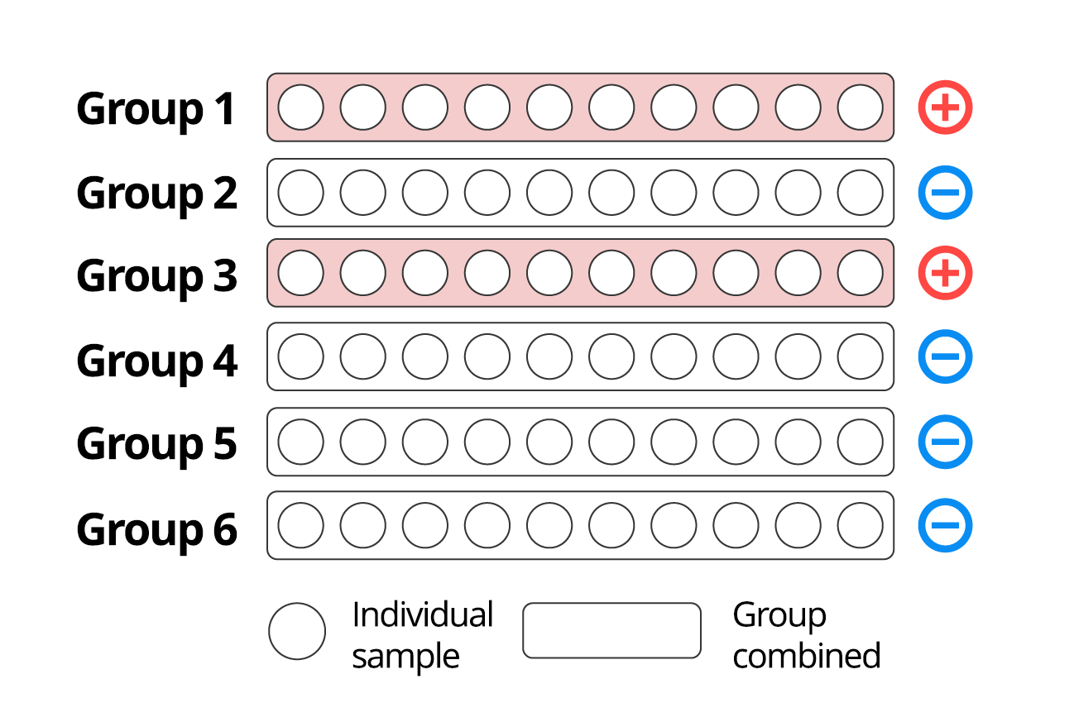
Understanding the technique
The figure depicts 60 blood samples that were pooled into six groups of 10 and then analyzed for the presence of a certain antibody. The groups that tested positive are marked in red:

Slide 5
Understanding the technique
How many individual tests must be performed to detect samples with the presence of the antibody?
How many tests in total should be performed in this situation to identify those that are positive?

Slide 6
Problem
To detect steroid use in 200 athletes participating in a sports competition, their urine samples will be analyzed using the pool testing strategy. The samples will be combined in groups of 10 athletes. It is known that the prevalence of steroid use in athletes in similar competitions, such as the 2018 Olympic Games, is 0,6%.
What is the probability that in a combined sample, at least one athlete will test positive for steroid use?

Slide 7
Activity 1
1. Consider the variable X = “number of positive individual samples in a combined sample” and answer:
What values can the variable X take?

Slide 8
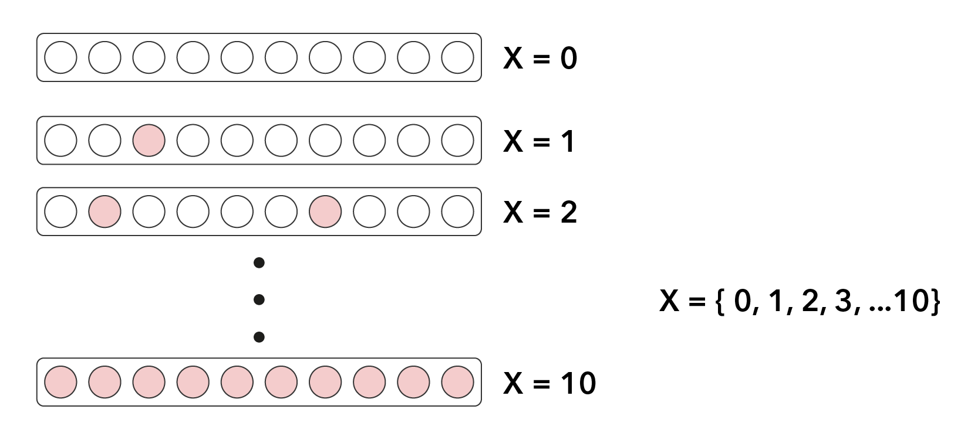
Activity 1
1. Consider the variable X = “number of positive individual samples in a combined sample” and answer:
What values can the variable X take?

Slide 9
Activity 1
Consider the variable X = “number of positive individual samples in a combined sample” and answer:
Why X is a random variable?

Slide 10
Activity 1
Consider the variable X = “number of positive individual samples in a combined sample” and answer:
Why X is a random variable?
Since it is impossible to know a priori the number of positive individual samples each group will have, X is a random variable.

Slide 11
Activity 1
Consider the variable X = “number of positive individual samples in a combined sample” and answer:
Express in mathematical terms the probability corresponding to the problem question.

Slide 12
Activity 1
Consider the variable X = “number of positive individual samples in a combined sample” and answer:
Express in mathematical terms the probability corresponding to the problem question.
What is the probability that in a pooled sample, at least one athlete tests positive for steroid use?
$$P(X≥1)$$

Slide 13
Assumption 1: Each experiment is modeled as a Bernoulli
What do we mean by a repeated experiment in this situation?
How many outcomes are possible in each experiment, and what are these?
What would you represent as success and failure in this experiment?
What are the probabilities of success and failure in this experiment?

Slide 14
Assumption 2: The experiments must be independent of each other
What does it mean for experiments to be independent of each other?
Is it reasonable to assume that an athlete's use or non-use of steroids is not affected by the use of other athletes?

Slide 15
Assumption 3: The probability of success is the same for each experiment.
Is it reasonable to assume that the probability of a sample testing positive for steroids is the same for each athlete?

Slide 16
Activity 2
What is the probability that a combined sample will test positive?

Slide 17
Activity 2
What is the probability that a combined sample will test positive?
$$P\left(X≥1\right)=1−P\left(X=0\right) \\ =1−\left({10 \atop 0}\right)⋅{0,006}^{0}⋅{0,994}^{10} \\ ≈1−0,94 \\ ≈6 \%$$

Slide 18
Activity 2
What is the probability that there will be more than one person who used steroids in a combined sample who tested positive?

Slide 19
Activity 2
What is the probability that there will be more than one person who used steroids in a combined sample who tested positive?
$$P\left(X>1\right)=1−P\left(X=0\right)−P(X=1) \\ =1−{0,994}^{10}−\left({10 \atop 1}\right){0,006}^{1}⋅{0,994}^{9} \\ ≈0,16 \%$$

Slide 20
Activity 2
Of the n = 20 samples combined, how many are expected to be positive? Interpret the result.

Slide 21
Activity 2
Of the n = 20 samples combined, how many are expected to be positive? Interpret the result.
$$E\left(X\right)=n⋅p \\ =20⋅0,006 \\ =0,12$$

Slide 22
Conclusions
Pool testing is a strategy that allows samples to be analyzed in groups, thus reducing the number of tests. It is beneficial when a large volume of samples needs to be analyzed quickly.

Slide 23
Conclusions
To model a situation using the binomial distribution, it must be verified that certain assumptions are met. These are:
that each experiment only has two possible complementary results,
that the experiments are independent of each other, and
that the probability of success is the same in each experiment.

Slide 24
Conclusions
Analyzing the assumptions behind using a mathematical model allows us to understand the situation better and interpret the solution to the problem.

Slide 25
Conclusions
The random variable X, defined as “the number of successes obtained in n experiments”, where each experiment is independent of the others and has a probability of success equal to p, is distributed as a binomial of parameters n and p.
This is usually denoted as:
$$X \sim Binomial (n,p)$$

Slide 26
Conclusions
When X corresponds to a binomial of parameters n and p, it can take the integer values between 0 and n. The probability of obtaining X = k successes is calculated by the formula:
$$P\left(X=k\right)=\left({n \atop k}\right)⋅p^{k}⋅{(1−p)}^{n−k}$$

Slide 27
Pool Testing

