Slide 1
The book of Sand

Slide 2
The book of Sand
Let’s review the video “The book of Sand”.
Notes:
*Note : If you have downloaded the video to your computer, you can edit the presentation to generate a hyperlink to the video from this slide.

Slide 3
The book of Sand
What is the story “The book of Sand” about?
What is the dilemma facing the protagonist?
Why can’t the protagonist reach the book’s first or last page?
Notes:
*Observación para el docente → Si tiene el video descargado en su computador, puede editar la presentación para generar un hipervínculo al video desde la diapostiva

Slide 4
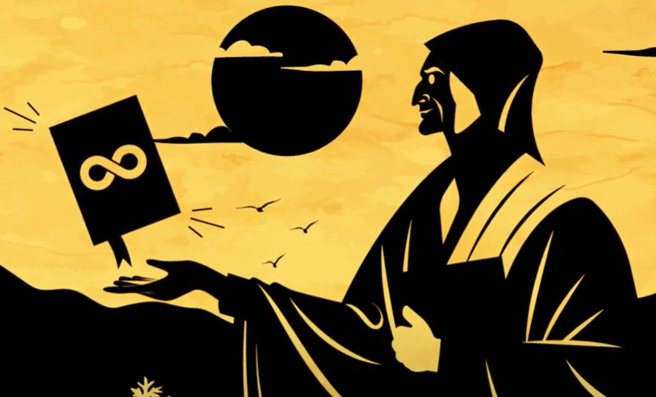
Some reflections
It is impossible to reach the first page of the book because, every time one tries to approach it, several pages appear. The same thing happens when one tries to get to the last page.
The protagonist cannot convince himself of the impossibility of reaching the first and last pages. However, the seller claims that “it can’t be, but it is.”
The seller assures that the book is infinite and that no page is the first or the last.

Slide 5
Important assumptions
Let us consider that the sand book has the following properties:
Each sheet has a sheet immediately before it and one immediately after it.
Given two book sheets, one can always get from one to the other by turning pages.
Activity 1
Let us consider the sheets of the Book of Sand as if they were numbers so that:
Each sheet correspond to a different number.
If one sheet is before another, a smaller number corresponds to it.
Is it possible to do this using natural numbers? Justify.

Slide 6
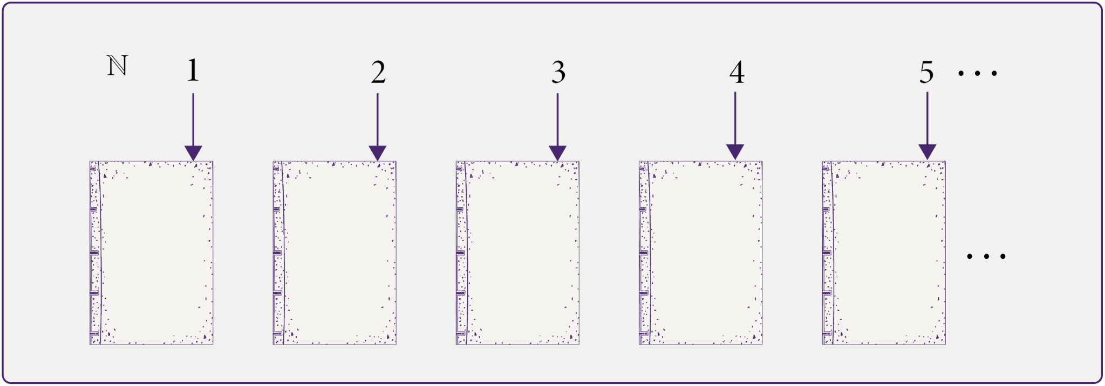
Activity 1
Since natural numbers have a first element, the first page could be reached from any other page, which contradicts the seller’s statement in the story that no page in the Book of Sand is the first.

Slide 7
Activity 2
As in the previous activity, let us consider the pages of the book of Sand as if they were numbers so that:
Each sheet corresponds to a different number.
If one sheet is before another, a smaller number corresponds to it.
Is it possible to do that using integers? Justify.

Slide 8
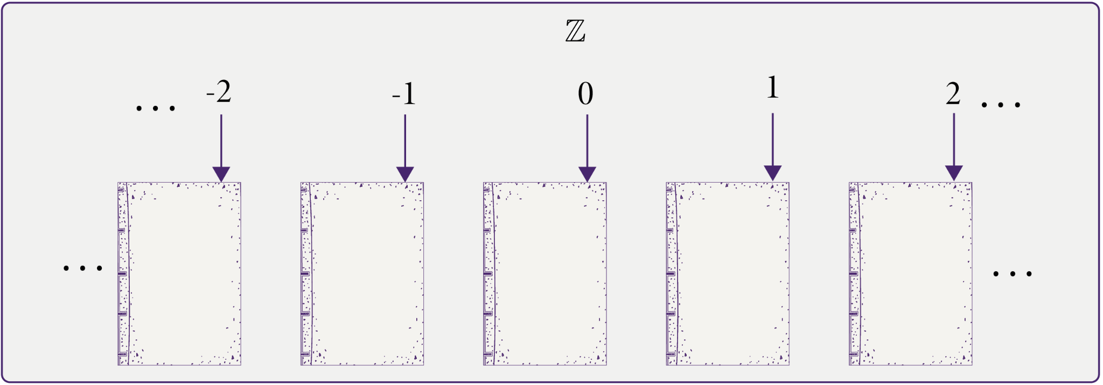
Activity 2
Because integers make up an ordered set without a first or last element, if we assigned these numbers to the pages of a book, we would obtain an infinite book where no page would be considered the first or the last.

Slide 9
Activity 2
It is essential to understand that the assumption that each sheet of the sand book has a previous sheet, and a next sheet allows us to associate them with integer numbers. Furthermore, as we can always get from one book sheet to another, each sheet is associated with an integer.

Slide 10
Activity 3
Let us now think of an imaginary book in which all its pages can be labeled in the following way:
We open this book on any page, and we assign it 1, to the previous one the number $\frac{1}{2}$ , to the one before that the number $\frac{1}{3}$, and so on.
With this procedure, we label only the sheet we chose and the previous ones. Later, we will see how to label the subsequent sheets.

Slide 11
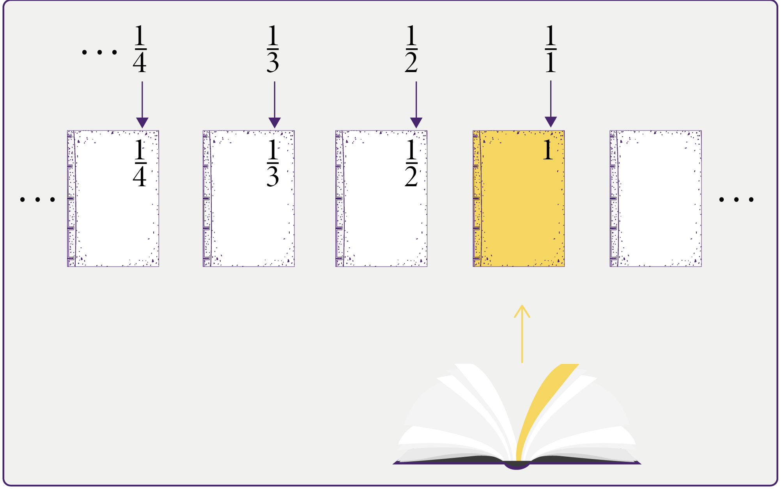
Activity 3

Slide 12
Activity 3
How many sheets are there between the sheeet labeled with the number $\frac{1}{ 10}$ and the sheet labeled with the number $\frac{1}{ 2}$, both included?
If m > n, both natural numbers, which sheet comes before, the one labeled $\frac{1}{ n}$ or the one labeled $\frac{1}{ m}$?
Does this book have a first sheet?
If we label the front cover, what number would be appropiate to assign it?

Slide 13
Activity 3
Between the sheet labeled with the number $\frac{1}{ 10}$ and the sheet labeled with the number $\frac{1}{ 2}$, there exactly 9 sheets, including both.
We know that if m > n, both natural numbers, then $\frac{1}{ m}$ < $\frac{1}{ n}$ . This means that the sheet labeled $\frac{1}{ m}$ will be before the one labeled $\frac{1}{ n}$ .

Slide 14
Activity 3
Given the number $\frac{1}{ n}$, where n is a natural number, it is always posible to find another natural number m > n so that $\frac{1}{ m}$ < $\frac{1}{ n}$ . This implies that, by locating ourselves on a sheet labeled $\frac{1}{ n}$ we can always find one labeled $\frac{1}{ m}$ that is located before. Consequently, the book cannot have a first page.
The sequence of numbers $1, \frac{1}{2},\frac{1}{3},\frac{1}{4}, …$ is getting closer and closer to 0 without reaching it. By associating the number 0 to the book’s cover, the sheets labeled with this sequence of numbers will get as close as we want to the cover, but they will never reacht it.

Slide 15
Activity 4
Let us continue labeling the sheets of the book from the previous activity as follows:
To the sheet following the one that we labeled with 1, we give the number
$$2−\frac{1}{2}=\frac{3}{2}$$
Which is followed by $2−\frac{1}{3}$, that is, $\frac{5}{3}$, which is followed by $2−\frac{1}{4}$, that is $\frac{7}{4}$, and so on.

Slide 16
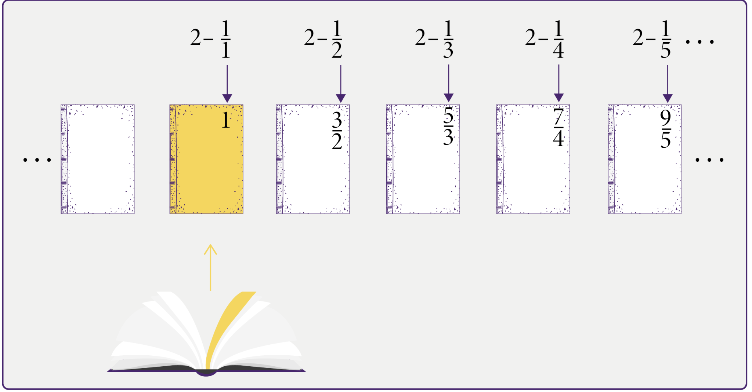
Activity 4

Slide 17
Activity 4
If we count 10 sheets starting from the one labeled with the number 1, what label does that sheet have?
How many sheets are there between the sheet labeled $\frac{1}{2}$ and the sheet labeled $\frac{9}{5}$, including both?
Does this book have a last sheet?
If we label the back cover, what number would be appropiate to assign it?

Slide 18
Activity 4
The book sheet labeling rule stablishes that the sheet in the n-th position, counted from the one with the number 1 onwards, is assigned the label $2−\frac{1}{n}$. Consequently, when counting 10 sheets, from the sheet labeled with the number 1, the resulting sheet is labeled $2−\frac{1}{10}=\frac{19}{10}$ .

Slide 19
Activity 4
The sheet labeled $\frac{1}{2}=1−\frac{1}{2}$ corresponds to the second sheet counted from the sheet 1 backwards. On the other hand, the sheet labeled, $\frac{9}{5}=2−\frac{1}{5}$ is the fifth sheet counted from the sheet 1 onwards. Therefore, between the sheet with the label $\frac{1}{2}$ and the sheet with the label $\frac{9}{5}$ , there are a total of 6 sheets, including both.

Slide 20
Activity 4
When placed on the sheet labeled $2−\frac{1}{n}$, there always exists a natural number m > n such that $2−\frac{1}{n}<2−\frac{1}{m}$ , which causes the sheet labeled $2−\frac{1}{m}$ to be found after $2−\frac{1}{n}$ . Consequently, the book cannot have a last page.
The sequence of numbers $2,\frac{3}{2},\frac{5}{3},\frac{7}{4}, …$ is getting closer and closer to 2 without reaching it. By associating the number 2 to the back cover of the book, the sheets labeled with this sequence of numbers will come as close as we want to the back cover but never reach it.

Slide 21
Conclusions
To label the sheets of the book, we use the terms of two sequences of rational numbers:
$$\left\{a_{n}\right\}=\{1,\frac{1}{2},\frac{1}{3},\frac{1}{4}, . . . \}$$
$$a_{n}=\frac{1}{n}$$
$$\left\{b_{n}\right\}=\{1,\frac{3}{2},\frac{5}{3},\frac{7}{4},. . . \}$$
$$b_{n}=2−\frac{1}{n}$$

Slide 22
Conclusions
The terms of the sequence $\{a_{n}\}$ get close as you want to 0 without ever reaching it. This behavior can be expressed with the following language and notation:
$$\lim_{n→∞}a_{n}=\lim_{n→∞}\frac{1}{n}=0$$
The sequence $\{a_{n}\}$ converges to 0.

Slide 23
Conclusions
The terms of the sequence $\{b_{n}\}$ get close as you want to 2 without ever reaching it. This behavior can be expressed with the following language and notation:
$\lim_{n→∞}b_{n}$= $\lim_{n→∞}\begin{matrix}\left(2−\frac{1}{n}\right)=2\end{matrix}$
The sequence $\{b_{n}\}$ converges to 2.

Slide 24
The Book of Sand

