Slide 1

The advance of the sea

Slide 2

The advance of the sea
Let’s review the infographic “Sea level rise”
Notes:
Note : If you have downloaded the infographic to your computer, you can edit the presentation to generate a hyperlink to the video from this slide.

Slide 3
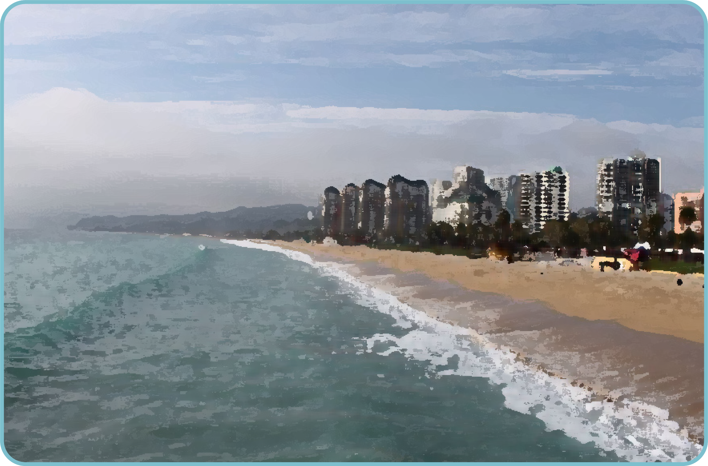
The advance of the sea
Why does climate change affect sea level rise?
How does the rise in sea level influence the coast of Chile?
Have you noticed the advance of the sea on any beach? Have you heard about this?

Slide 4
Problem
Read the following situation:
Different predictions have been made about the speed at which the sea will advance in some locations of the Chilean coast. Below are two of them:
    In Antofagasta, the sea's advance rate will be 6 meters every 10 years.
In Constitución, the sea's advance rate will be 8 meters every 10 years.

Slide 5

Problem
Read the following situation:
Different predictions have been made about the speed at which the sea will advance in some locations of the Chilean coast. Below are two of them:
    In Antofagasta, the sea's advance rate will be 6 meters every 10 years.
In Constitución, the sea's advance rate will be 8 meters every 10 years.
What is the rate of advance of the sea for each area?
What does it mean that the sea's advance rate in Antofagasta is 6 meters every 10 years?
If the pace continues, what would be the progress after 20 years? Why?

Slide 6
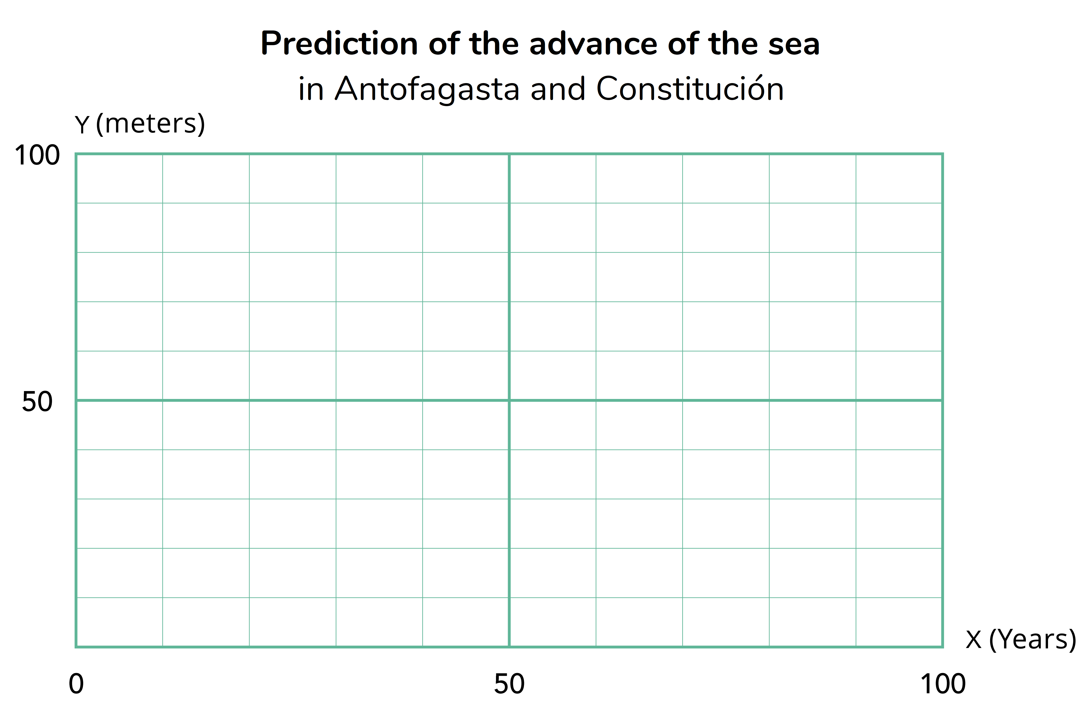
Activity
1. Draw the graphs of the predictions of the advance of the sea for each of the coastal areas mentioned.

Slide 7
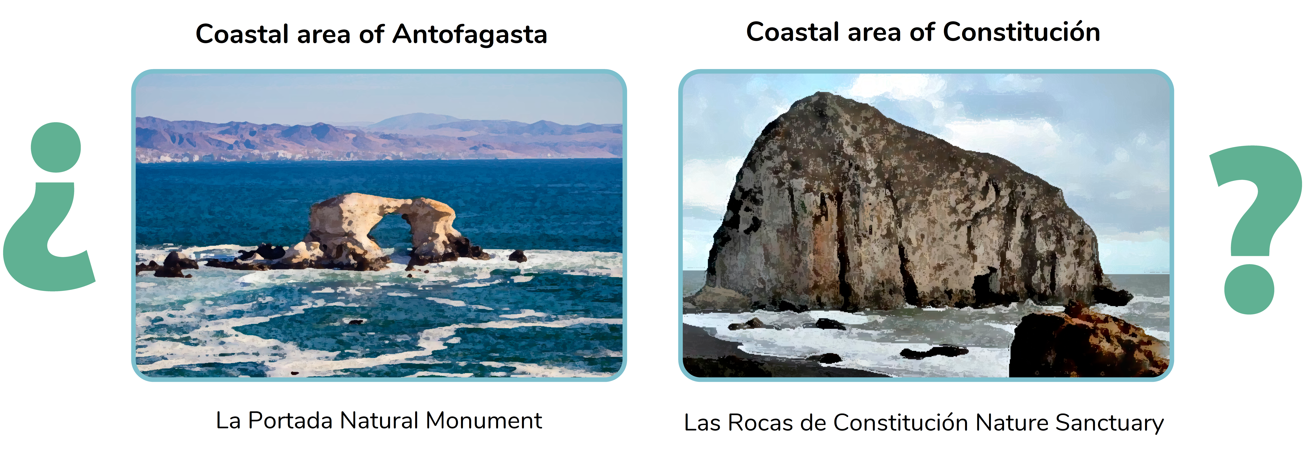
Activity
2. In which coastal area is the sea advancing the fastest? How does it relate to the graph?

Slide 8
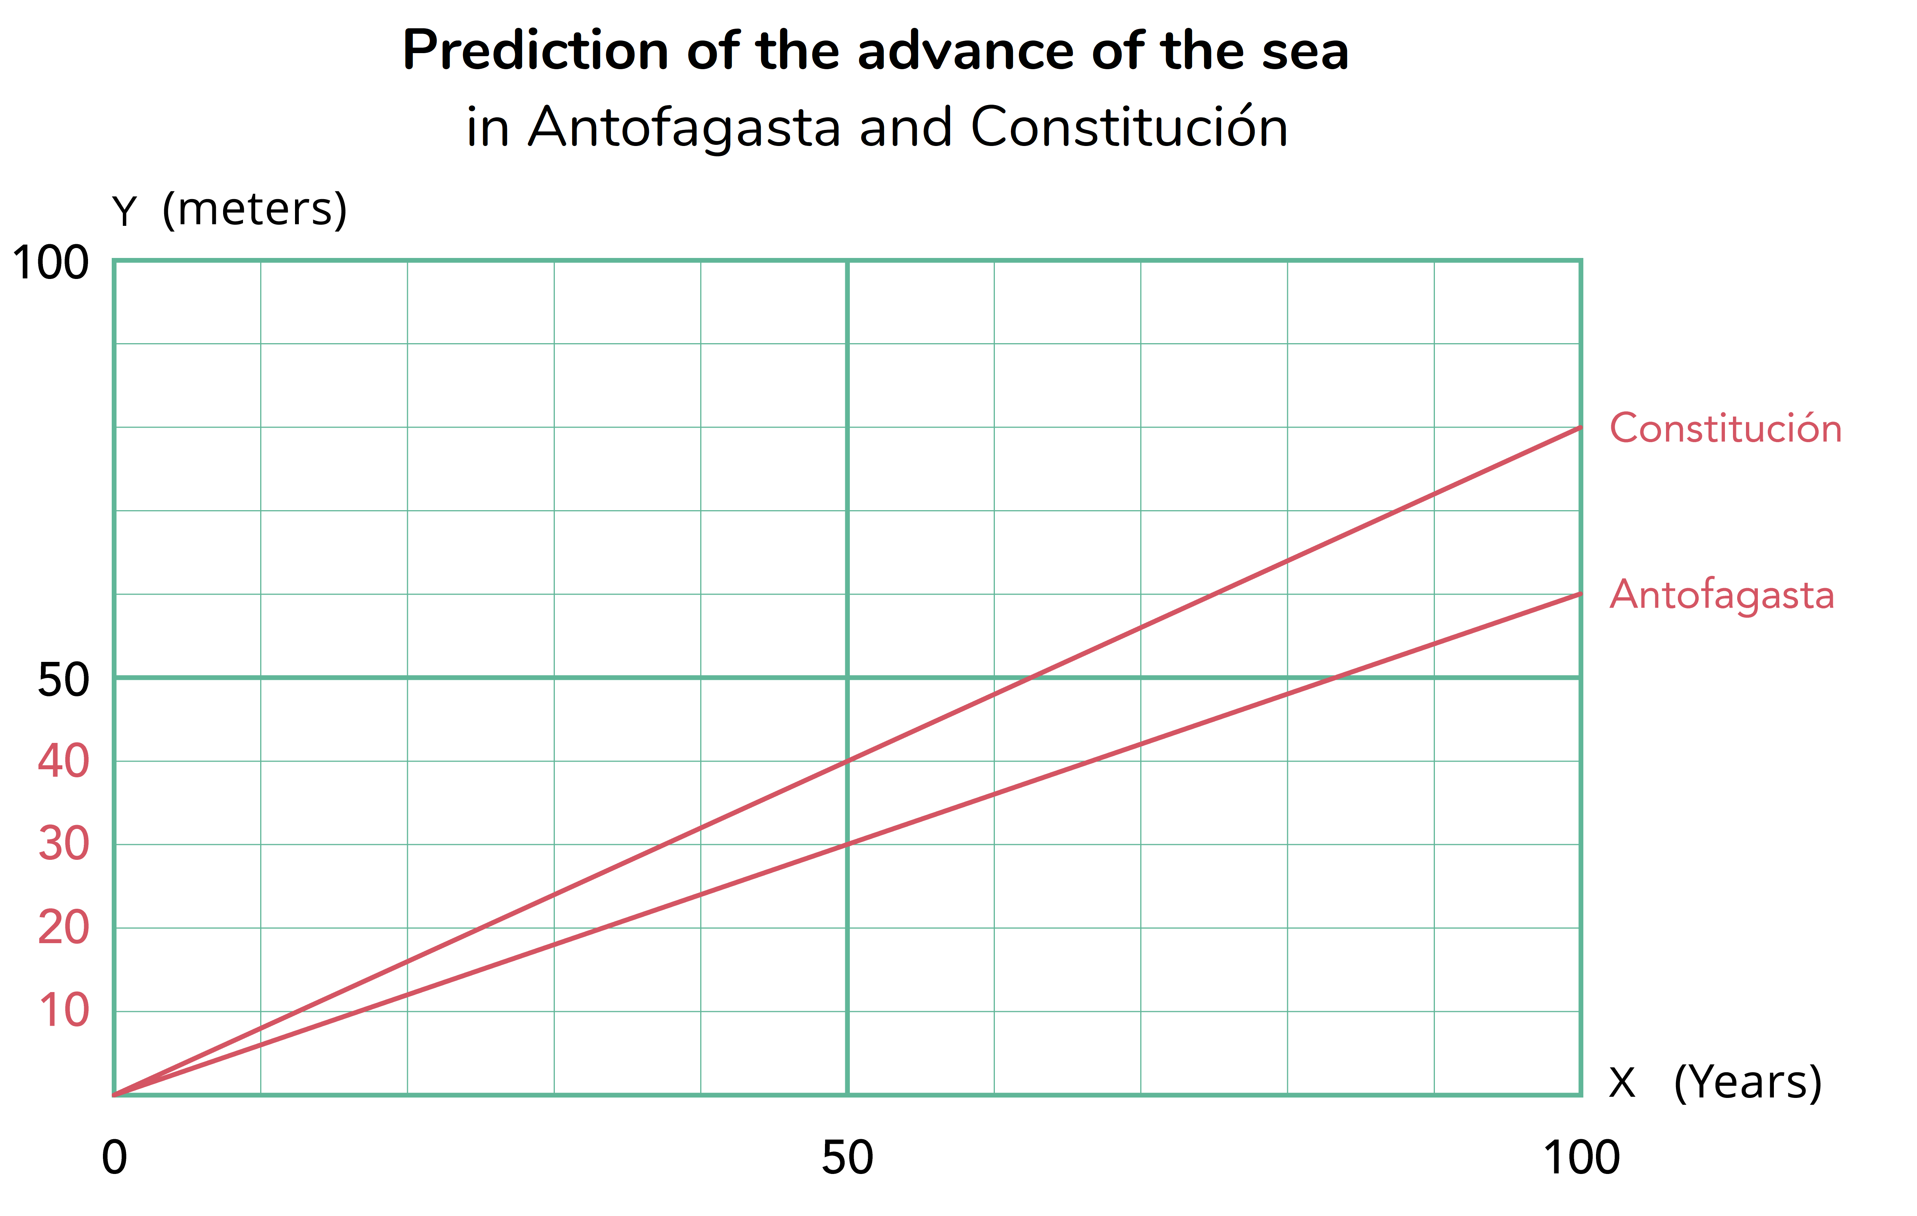
Activity
Let’s analize the situation
2. In which coastal area is the sea advancing the fastest? How does it relate to the graph?

Slide 9
Activity
Let’s analize the situation
In Constitución the sea advances 8 meters every 10 years, while in Antofagasta it advances 6 meters in the same period of time.
The line of advance of the sea in Constitución is above the line of advance of the sea in Antofagasta

Slide 10
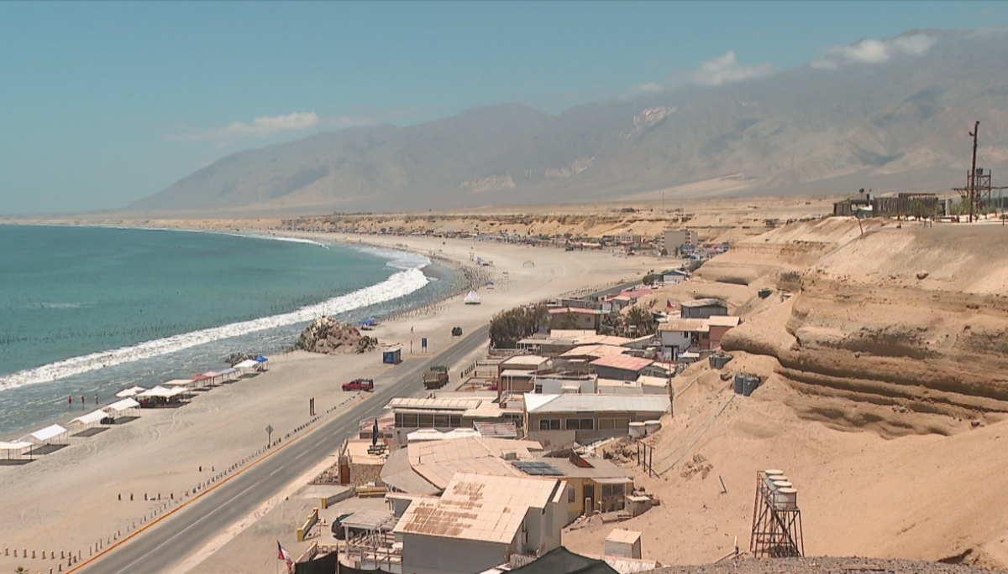
Activity
3. How many meters will the sea have advanced in Antofagasta and Constitución in 50 more years?

Slide 11
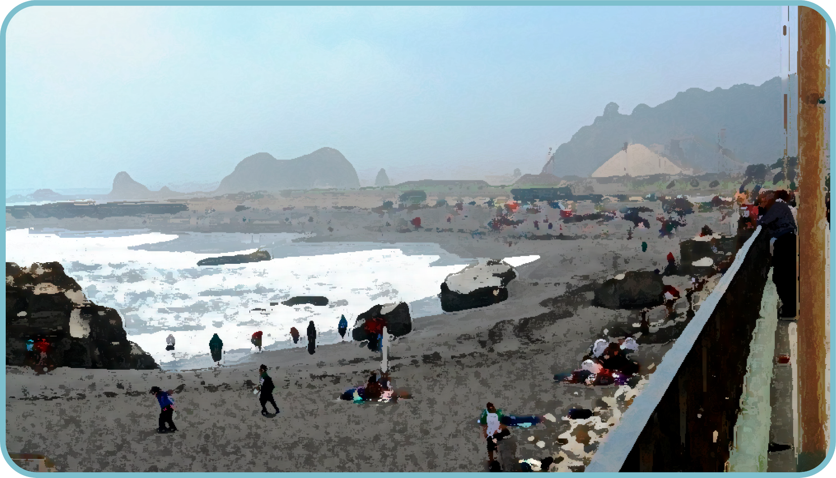
Activity
4. How many meters will the sea have advanced in Antofagasta and Constitución in 30 more years?

Slide 12

Activity
5. Write a formula that describes the relationship between time and the advance of the sea for the coastal areas of Antofagasta and Constitución.

Slide 13
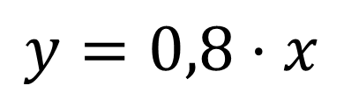
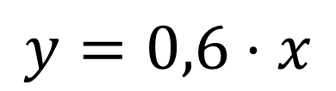
Activity
5. Write a formula that describes the relationship between time and the advance of the sea for the coastal areas of Antofagasta and Constitución.
In Antofagasta
In Constitución
$$y=0,6⋅x$$
$$y=0,8⋅x$$
Where
x is the time elapsed in years and
y the advance of the sea in meters in Antofagasta.
Where
x is the time elapsed in years and
y the advance of the sea in meters in Constitución.

Slide 14
Activity
6. Use the formulas to calculate the advance of the sea after 2 years.
In Antofagasta
In Constitución
$$y=0,6⋅x$$
$$y=0,8⋅x$$
Where
x is the time elapsed in years and
y the advance of the sea in meters in Antofagasta.
Where
x is the time elapsed in years and
y the advance of the sea in meters in Constitución.

Slide 15
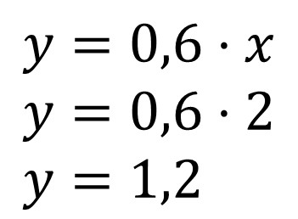
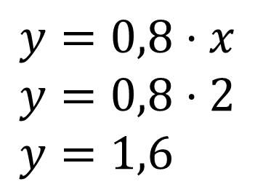
Activity
Let’s analize the situation
6. Use the formulas to calculate the advance of the sea after 2 years.
In Antofagasta
In Constitución
$$y=0,6⋅x \\ y=0,6⋅2 \\ y=1,2$$
$$y=0,8⋅x \\ y=0,8⋅2 \\ y=1,6$$
In 2 more years, the sea will advance 1,2 meters (1 m and 20 cm)
In 2 more years, the sea will advance 1,6 meters (1 m and 60 cm)

Slide 16
Activity
7. In 2023, houses were built a few meters from the beach in the coastal area of Antofagasta and Constitución.
In Antofagasta, the house is 15 meters from the coast.
In Constitución, the house is 20 meters from the coast.
a) In each case, write on the signs the year the sea will advance the indicated meters.
b) Which house will the sea reach first? In what year?

Slide 17
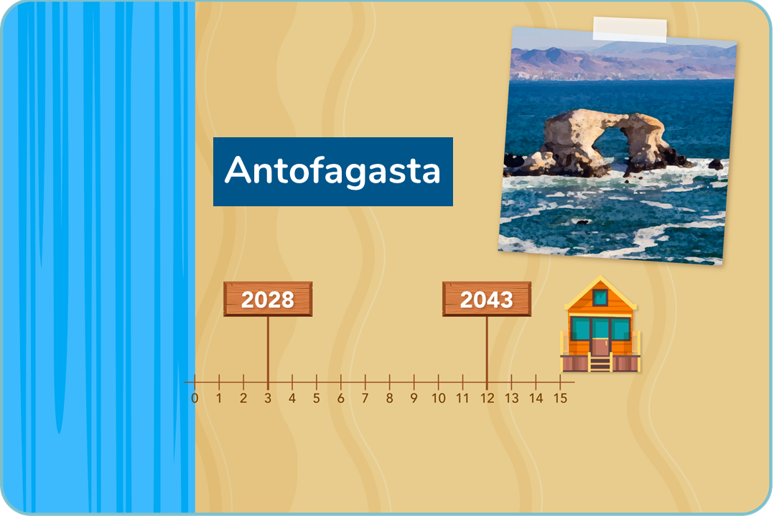
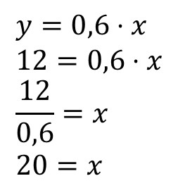
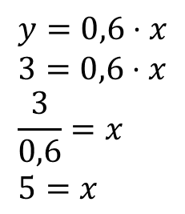
Activity
Let’s analize the situation
a) In each case, write on the signs the year the sea will advance the indicated meters
3 meters advance
12 meters advance
$$y=0,6⋅x \\ 3=0,6⋅x \\ \frac{3}{0,6}=x \\ 5=x$$
$$y=0,6⋅x \\ 12=0,6⋅x \\ \frac{12}{0,6}=x \\ 20=x$$
In the year 2028 (2023 + 5), the sea will have advanced 3 meters.
In the year 2043 (2023 + 20), the sea will have advanced 12 meters.

Slide 18
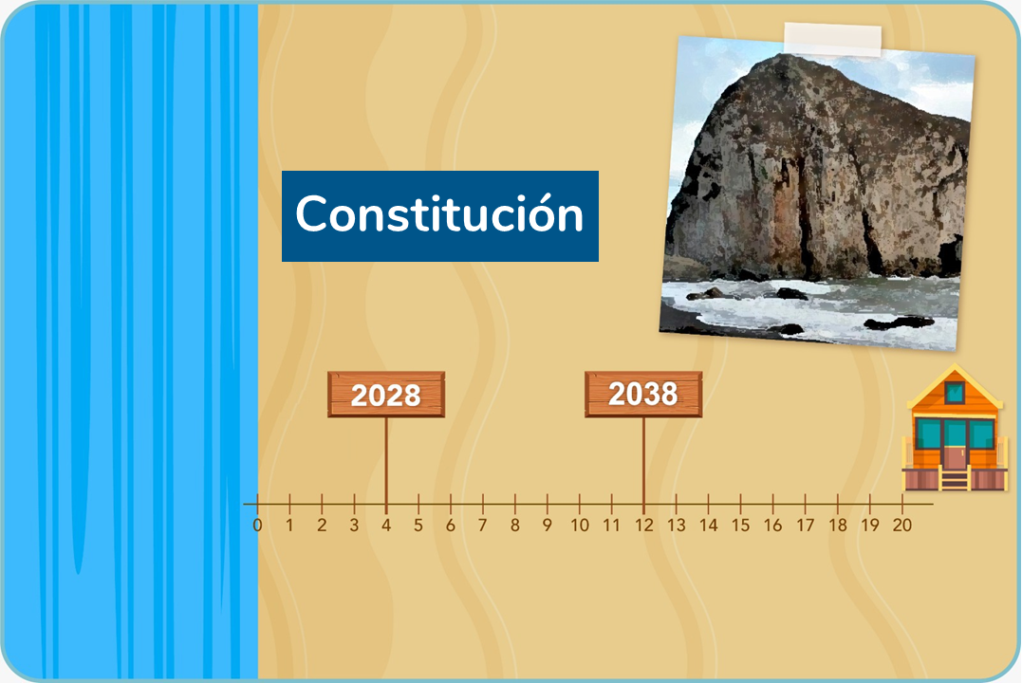
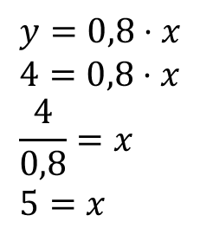
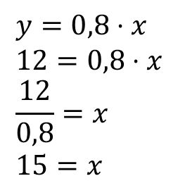
Activity
Let’s analize the situation
a) In each case, write on the signs the year the sea will advance the indicated meters
4 meters advance
12 meters advance
$$y=0,8⋅x \\ 4=0,8⋅x \\ \frac{4}{0,8}=x \\ 5=x$$
$$y=0,8⋅x \\ 12=0,8⋅x \\ \frac{12}{0,8}=x \\ 15=x$$
In the year 2028 (2023 + 5), the sea will have advanced 4 meters.
In the year 2038 (2023 + 15), the sea will have advanced 12 meters.

Slide 19
Activity
Let’s analize the situation
b) Which house will the sea reach first? In what year?
In Antofagasta
In Constitución
In the year 2048 the sea will reach the house that is 15 meters from the coast.
In the year 2048 the sea will reach the house that is 20 meters from the coast.
In both houses the sea will reach in 2048!

Slide 20
Conclusions
The predictions given on the advance of the sea in coastal areas express a relationship of direct proportionality between the variables. That is, it is assumed that the rate of sea advance is constant. This relationship can be represented by a straight line passing through the origin.
The proportionality constant of the advance of the sea in Constitución is greater than that of Antofagasta, which indicates that its rate of advance is faster. Thus, in the graph, the line corresponding to Constitución is above that of Antofagasta.

Slide 21


Conclusions
In order to describe the relationship of direct proportionality through an algebraic expresión, it’s necessary to find the proportionality constant. For that, we identified the advance of the sea after one year in each coastal area.
For example, in Antofagasta, where “the sea's advance rate will be 6 meters every 10 years” we can express it as “an advance of 0,6 meter each year”. Thus, if x is the time elapsed in years and y the advance of the sea in meters in Antofagasta, we have,
Likewise, we obtain that for Constitución,
$$y=0,6⋅x$$
$$y=0,8⋅x$$

Slide 22
Conclusions
Using the direct proportionality formulas, we can determine the advance in meters of the sea in each area as a function of the time elapsed
In addition, we can calculate the number of years necessary for the advance of the sea to reach a certain number of meters.

Slide 23

Conclusions
This situation allowed us to quantify the rise in sea level due to climate change. Using mathematics is essential to adopt preventive measures and reduce the impact and consequences for the population and the environment.

Slide 24
The advance of the sea

